Slide 1
The RF ChatterBox A Low-Cost Frequency Analyzer
GROUP 6
Lance O’Sullivan | EE
Alexander Long | EE
Jakub Nishioka | EE
Julian Duque | CpE

Slide 2
Overview
Design, test, and construct an automated system which allows for the collection and visualization of frequency strength data.
Motivations
Current equipment is very expensive​
Researchers will be able to view and estimate signal strengths across broad areas
Ability to work with hardware integration, communications, power, and server development

Slide 3
Specifications
Targeted Frequencies | 240 MHz – 960 MHz: ISM Bands Television 2.4 GHz: Wi-Fi Bluetooth
Battery Life | Minimum 12 hours
Small Footprint | Maximum of 10"x6"x6"
Operate in outdoor environment | Up to 140 °F

Slide 4
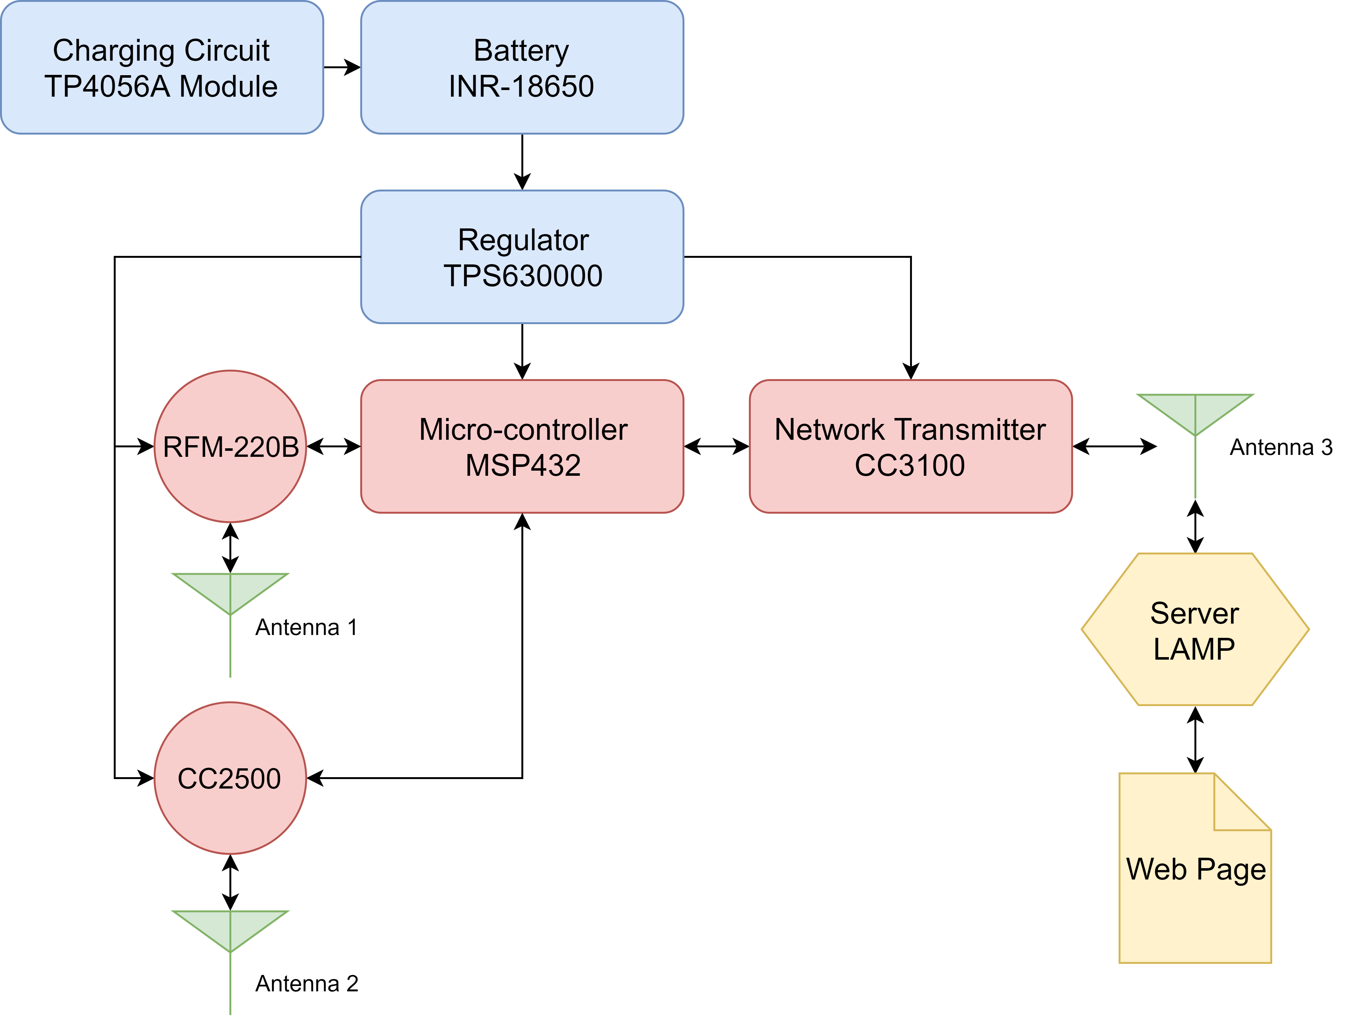
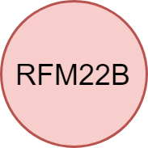
Project Top-Level View

Slide 5
Microcontroller Comparison (32-bit)
TI MSP432P4011 | MICROCHIP ATSAM4LC4B
ARM Cortex M4F w/ Frequency 48MHz | ARM Cortex M4F w/ Frequency 48MHz
256 kB RAM | 64 kB RAM
2 MB Flash | 512 kB Flash
6 Serial I/O Ports | 1 Serial I/O Port
Operating Voltage: 1.7V - 3.3V | Operating Voltage: 1.7V - 3.3V
5 Different Low Power Modes | picoPower for ultra-low power consumption
Previous experience from School | Embedded voltage regulator

Slide 6
Microcontroller Comparison (32-bit)
TI MSP432P4011 | MICROCHIP ATSAM4LC4B
ARM Cortex M4F w/ Frequency 48MHz | ARM Cortex M4F w/ Frequency 48MHz
256 kB RAM | 64 kB RAM
2 MB Flash | 512 kB Flash
6 Serial I/O Ports | 1 Serial I/O Port
Operating Voltage: 1.7V - 3.3V | Operating Voltage: 1.7V - 3.3V
5 Different Low Power Modes | picoPower for ultra-low power consumption
Previous experience from School | Embedded voltage regulator

Slide 7
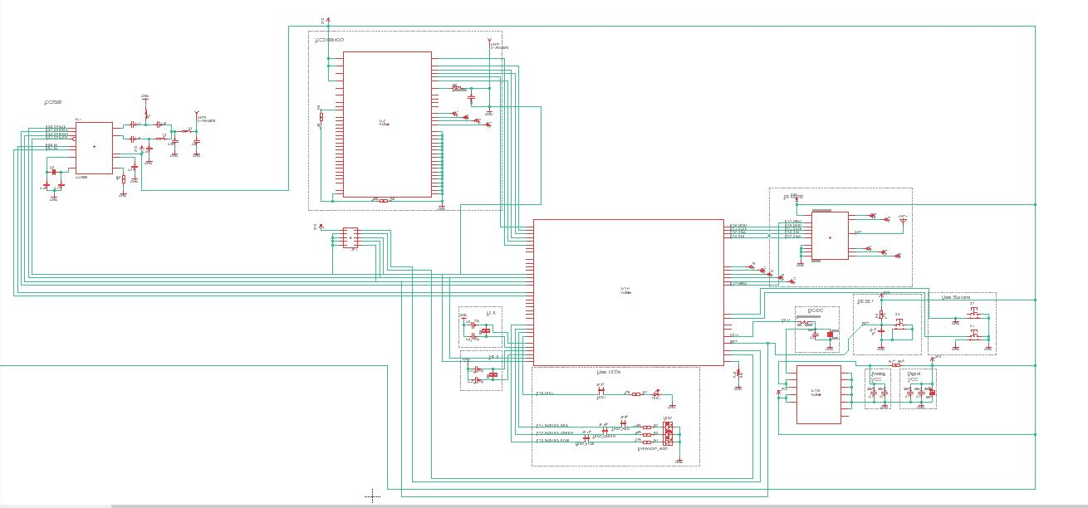

Slide 8
2.4 GHz RSSI Sensor: TI CC2500
High sensitivity (-104dB)
Digital RSSI Output
0.5 dB Resolution
Uses SPI as communication protocol
Existing libraries that work with MSP432
3.3V Operating Voltage

Slide 9
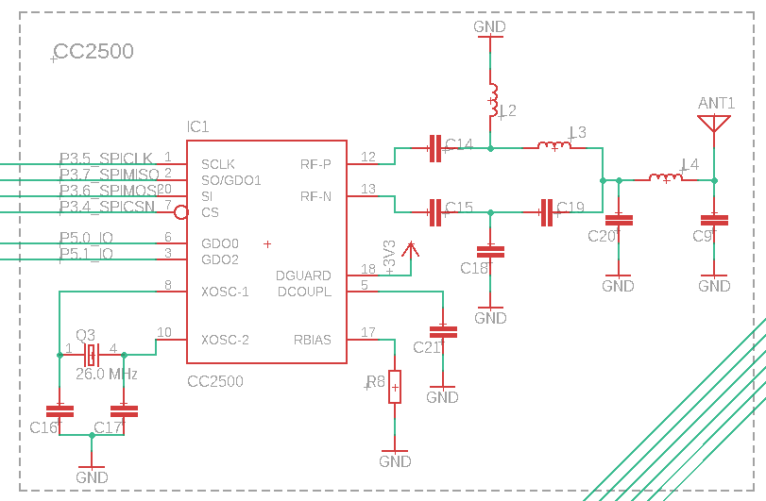
TI CC2500 Sensor Schematic

Slide 10
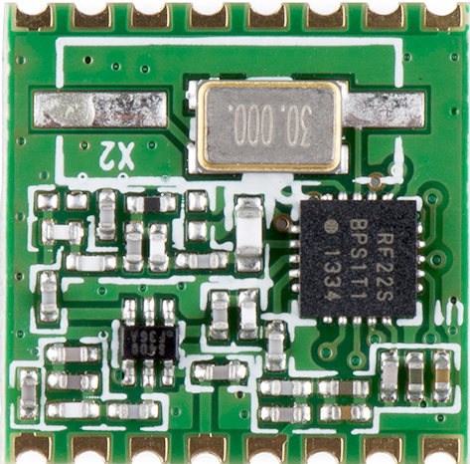
240 MHz – 960 MHz RSSI Sensor: RFM22B
High sensitivity (-121 dBm)
Frequency control registers allow operation from 240-960 MHz
RSSI readout from 8-bit register
Uses SPI as communication protocol

Slide 11
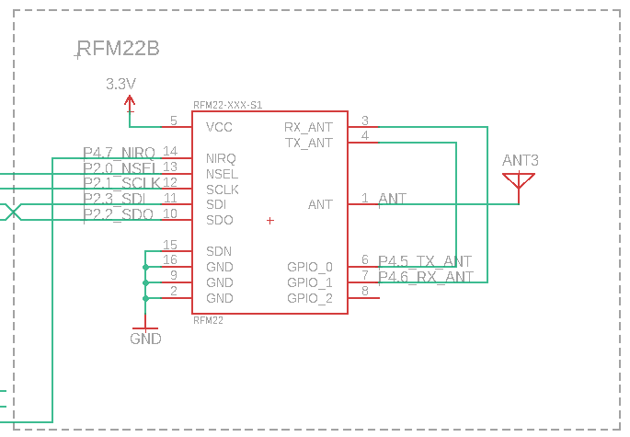
RFM22B Sensor Schematic

Slide 12
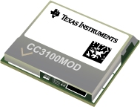
Network Processor: TI CC3100MOD
802.11 b/g/n
Uses the HTTP Protocol to connect with server
Maximum 4000 Byte transmit buffer
Integrated components:
Power management subsystem
Internal oscillator
Low power modes
Uses SPI as communication protocol

Slide 13
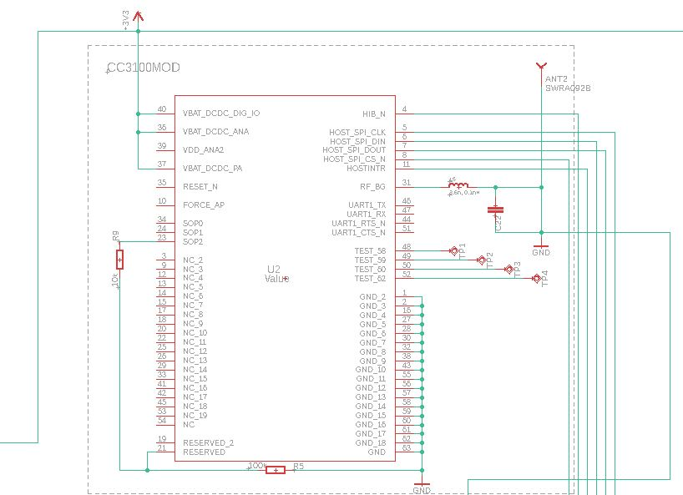
TI CC3100MOD Processor Schematic

Slide 14
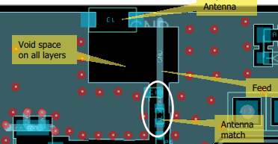
Impedance Matching
Prevents reflection of signals when switching mediums
Improves efficiency between the antenna and the receiver and prevents damage of components
Typically simple LC circuits

Slide 15
Battery: INR-18650
Lithium Ion Technology
3000mAh capacity
3.6 cell voltage
Size of an AA battery
600mA Discharge Current

Slide 16
Charge Control: TP4056A Module
Combination of:
TP4056 - Charges battery using Constant Current, Constant voltage method
DW01A - Monitors discharge current
FS8205A – Dual Channel MOSFET used for switching circuit state
Overcharge and Discharge Protection
Optimal 1A Discharge Current

Slide 17
Voltage Regulation: TPS63000 Module
Input Range of 1.2V to 5V
Can act as a Buck or Boost regulator
Constant output voltage of 3.3V
Max Current of 1.2A
Peak 96% efficiency

Slide 18
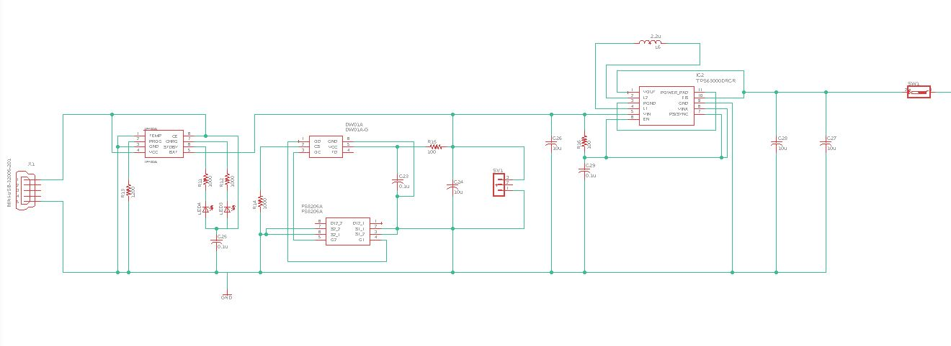
POWER SCHEMATIC

Slide 20
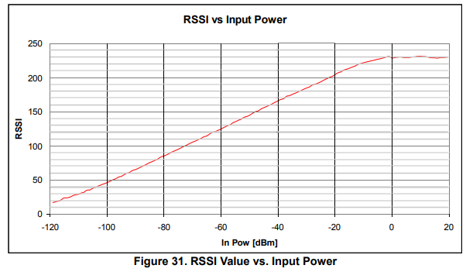
Antenna
Metal | Conductivity (1/Ωcm)
Silver | 106
Copper (pure) | 100
Copper (hard Drawn) | 89.5
Aluminum | 45
Steel | 3-15
Half wavelength
RFM – 6.6 inches
Vertically polarized
Omni-directional
Wire Antenna
- Copper:
Low cost
High conductivity
Easy to solder
Resistant to stretching, damage, being moved out of place
20 dBm = 0.1 Watt

Slide 21
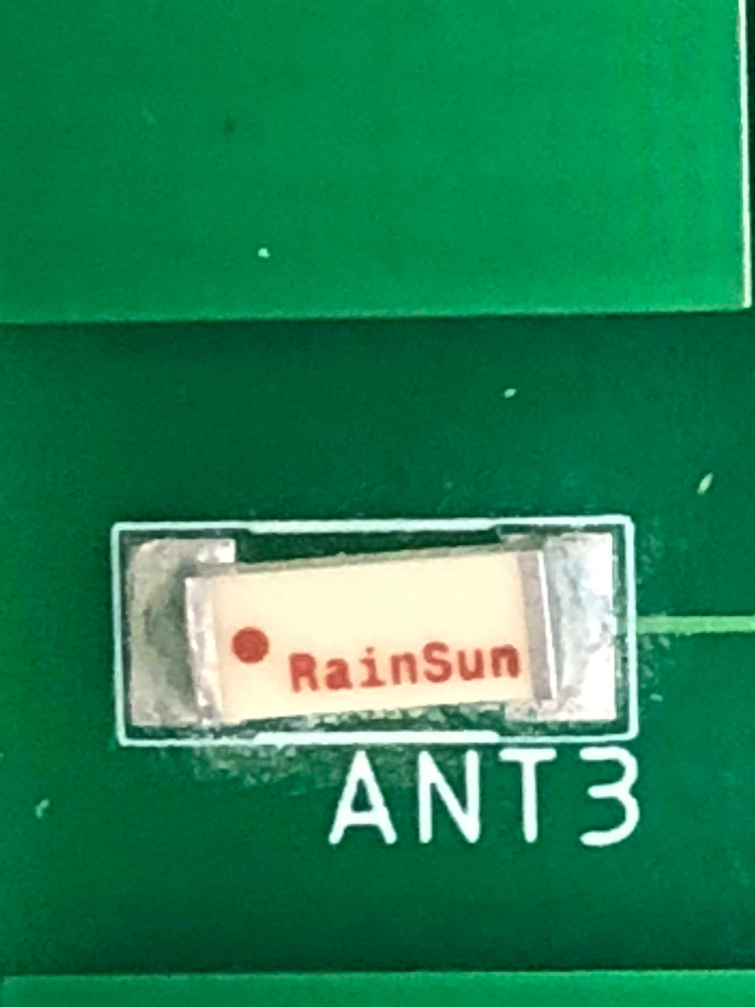
Rainsun Microwave Tech AN2051-245
For CC3100 and CC2500
Item | Specification
Center Frequency | 2.45 GHz
Bandwidth (typ.) | 110 MHz
Peak Gain (typ.) | 0.5 dBi
Voltage Standing Wave Ratio (VSWR) | 2.0 (max)
Pattern | Omni-directional
Impedance | 50 Ω
Dimensions | 5.1mm(L)×2.0mm(W)×1.2mm(H)

Slide 22
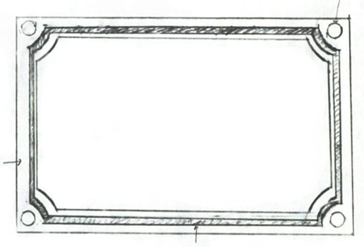
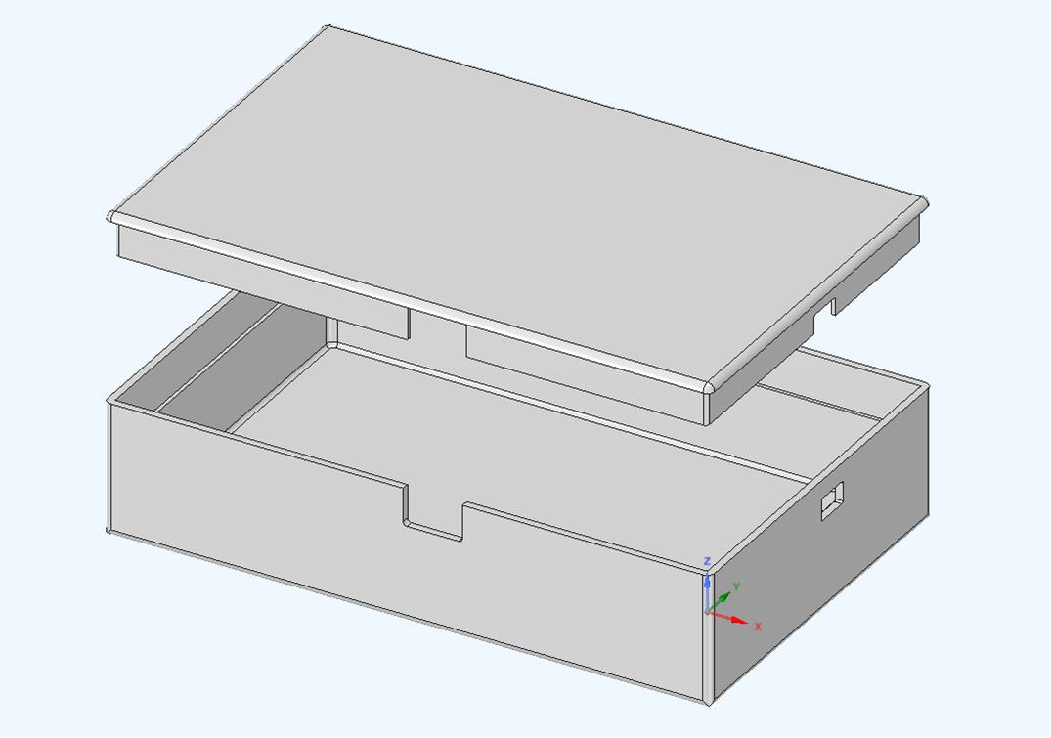
Enclosure Design
Prototype design provides protection for the PCB and Battery
Slots were added to allow access to the switch and USB Port
3D printed with ABS Plastic - makes it lightweight, durable for outdoor use
Size: 6.5"(L) x 4"(W) x 1.5"(H)

Slide 23
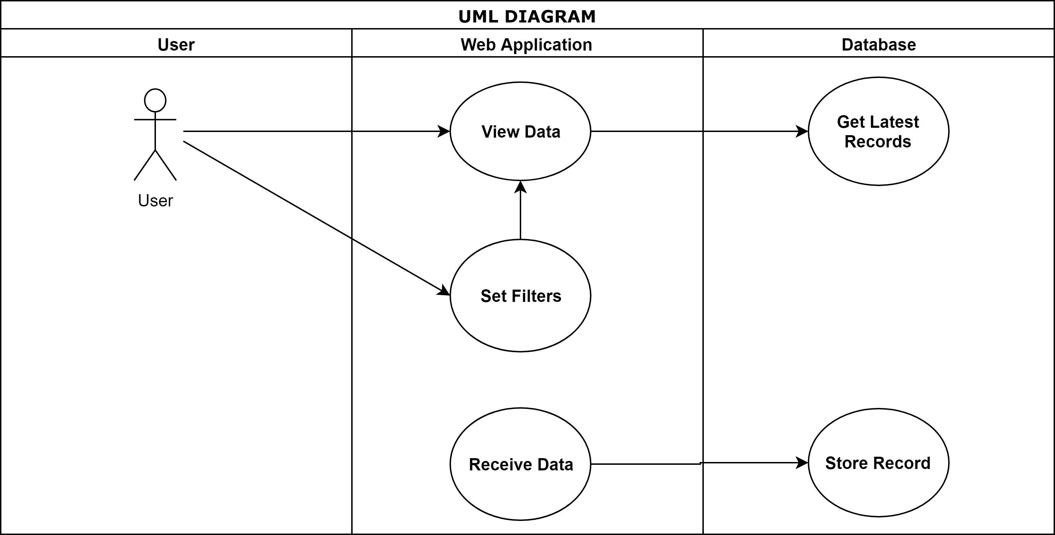
Software User Case
Improvements to be made:
Ability to retrieve data in datasheet format (csv)
Include ability to read status messages from each individual board

Slide 24
LAMP Stack
Stack​ | Free​ | Previous Experience​ | Configuration Time​ | Technologies
LAMP​ | X​ | X​ | Low​ | Linux, Apache, MySQL, PHP
MEAN​ | X​ |  | High​ | MongoDB, Express.js, Angular JS, Node.js
WISA​ |  | X​ | High​ | Windows, IIS, SQL Server, ASP.NET
Advantages
Free for development purposes
Fast setup time
Experience from previous projects
Disadvantages
Not learning something new
Not free if storing large amounts of data

Slide 25
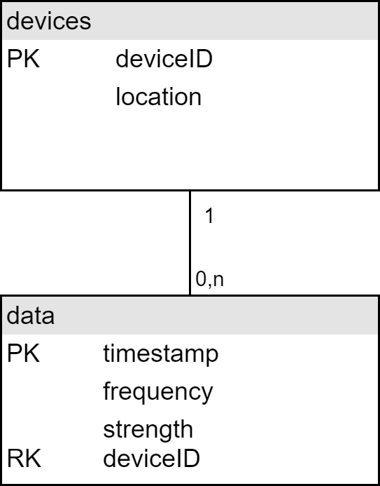
Database
Database is stored in Amazon Web Services Relational Database Systems
Having a single table for devices allows us to store the location for each device
Using 6 devices we can store data continuously for a month without exceeding storage limits
Limit for free tier is ~20 GB
Amazon RDS automatically creates a backup of data every 24 hours

Slide 26
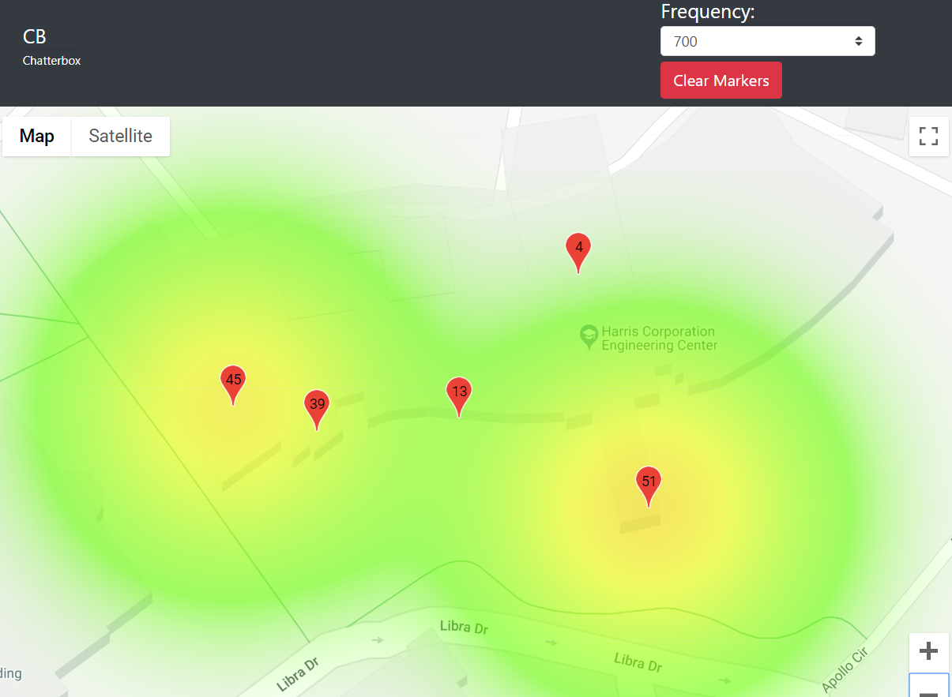
Webpage
Website holds a heatmap created using the Google Maps API
Updated with the latest data received by the server
Color Scale:
Red indicates high, green is low
Decay ratio simulated by using FSPL average of 10 closest measured points
FSPL =(4π*D*F/c)²*
Radius calculated by solving for distance and solving at 80 dB
D$={10}^{\text{(} \frac{80 − 32.44 − 20 ∗ log10(f) }{20}\text{) }}$*
FSPL = Free Space Path Loss Ratio Equation, D = Distance in meters, F = Frequency in KHz, c = speed of light in meters per second

Slide 27
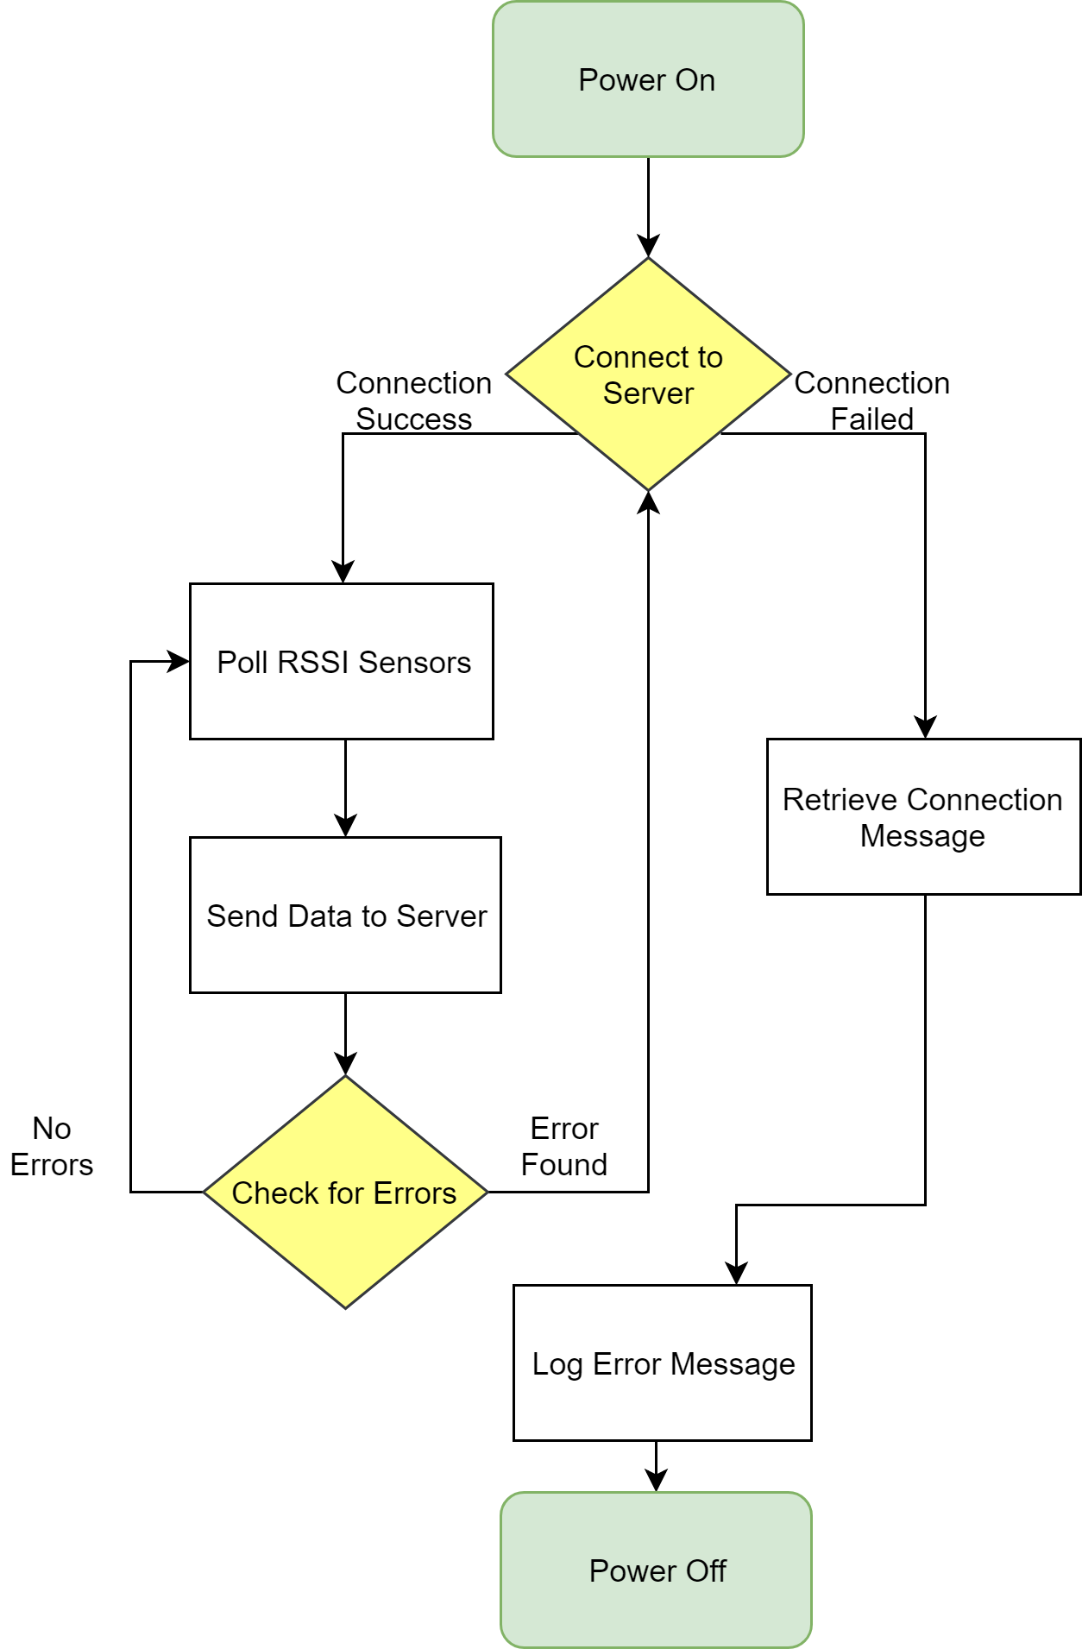
MCU Logic
Device holds log of all errors for further testing
If it is not able to connect to the Wi-Fi SSID it will simply turn off
Sends 15 measured records to server in one package to optimize Battery Life
Buffer limit is 4000 Bytes
Measures 10 times and takes average for better data accuracy

Slide 28
Technologies
Type | Name
IDEs | Visual Studio 2017 Code Composer Studio 2016
Server Hosting | Heroku
Database | Amazon Web Services RDS MySQL Workbench
Respository | Github
Device Flashing Software | Uniflash
UART terminal | Tera Term
Programming Languages | JavaScript, HTML, PHP, C

Slide 29
Workload
Name | Responsibilities
LANCE O'SULLIVAN | Design and implement power system Design and test PCB
JAKUB NISHIOKA | Integrate microcontroller and sensors Design and test PCB
ALEX LONG | Antenna design for transceivers Program microcontroller
JULIAN DUQUE | Create webpage and configure server Program microcontroller

Slide 30
Cost Evaluation
Component | Price | Qty | Total
MSP432P401RIRGCR | $6.86 | 1 | $6.86
CC2500RGPR | $2.84 | 1 | $2.84
CC3100MODR11MAMOBR | $13.56 | 1 | $13.56
RFM22B | $4.76 | 1 | $4.76
TP4056 | $0.58 | 1 | $0.58
DW01A | $0.01 | 1 | $0.01
FS8205A | $0.24 | 1 | $0.24
TPS63000DRCR | $2.27 | 1 | $2.27
INR-18650 | $3.50 | 1 | $3.50
AN2051-245 | $0.25 | 2 | $0.50
Copper Wire | $0.10 | 1 | $0.10
26 MHz Oscillator | $0.50 | 1 | $0.50
Passive Components | $2.50 | 1 | $2.50
PCB Manufacturing | $3.00 | 1 | $3.00
Total |  |  | $41.22

Slide 31
RF ChatterBox Progress

Slide 32
Major Obstacles and Solutions
Obstacle | Solution
CC3100 and CC3200 are both optimized to work with WPA and not WPA2_ENT | Developed method to use a certificate to obtain the WPA2_ENT settings
RFM22B has very limited documentation on working with TI Products. It was created to work with the ATMEGA (Arduino) MCU | Spent extra man hours to translate the libraries into the TI environment
The first revision of the PCB had signals shorted together, causing errors with the JTAG connection | Performed Design Rules Check according with MCU manufacturer to entire PCB design before being sent for manufacturing
CC3100 Host Control/Flash Program pins absent from PCB design. | Used CC3200 development board to replace capabilities of CC3100

Slide 33
Questions?

Slide 34
DEMO
http://chatt3rb0x.herokuapp.com/​

Slide 35
Meeting Specifications
Targeted Frequencies | 240 MHz – 960 MHz: ISM Bands Television 2.4 GHz: Wi-Fi Bluetooth
Battery Life | Minimum 12 hours
Small Footprint | Maximum of 10"x6"x6"
Operate in outdoor environment | Up to 140 °F

Slide 36
Battery Life​ | Minimum 12 hours​

Slide 37
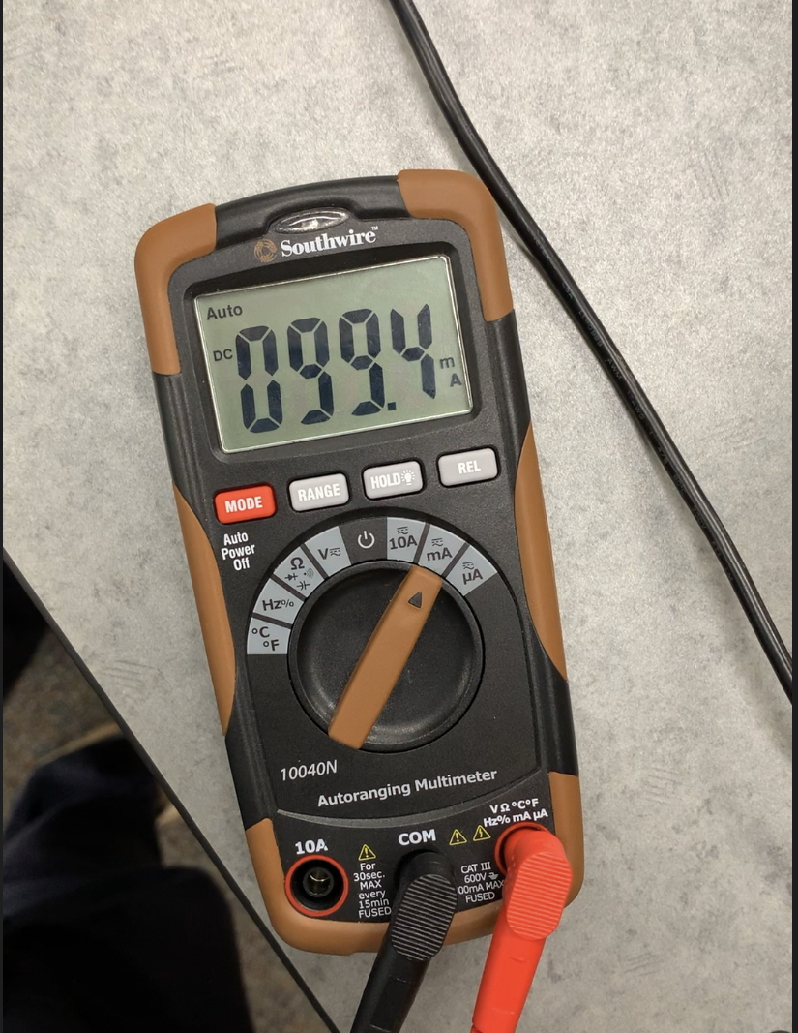
Battery Life​ | Minimum 12 hours​
Battery Capacity: 3000 mAh
Peak Measured Current: 100 mA
Battery Life = Battery Capacity / Measured ~ 30 hours

Slide 38
Small Footprint​ | Maximum of 10"x6"x6"​

Slide 39
Small Footprint​ | Maximum of 10"x6"x6"​
Actual Size: 6.5"(L) x 4"(W) x 1.5"(H)

Slide 40
Targeted Frequencies​ | 240 MHz – 960 MHz:​ ISM Bands​ Television ​ ​ 2.4 GHz:​ Wi-Fi​ Bluetooth​

